Slide 1

5 cool scientific inventions
By Anirudh Vempati

Slide 2

Hello

Slide 3

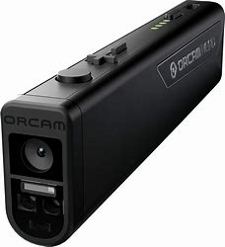
OrCam Read Release date: July 2023

Slide 4

Dall-e Release date: January 5, 2021

Slide 5
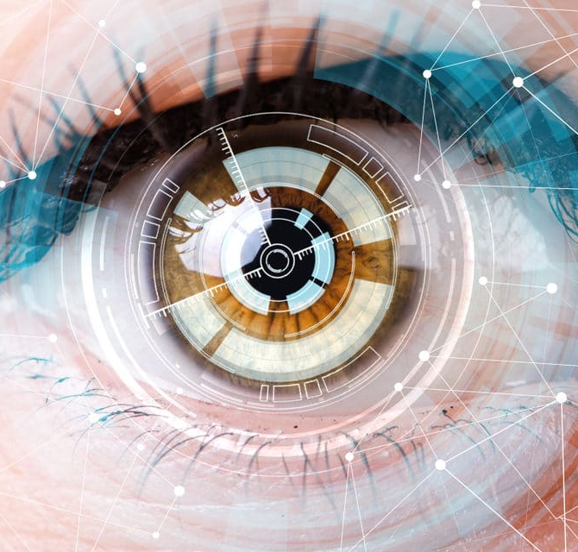
Bionic Eye Release date: 2021

Slide 6

LLaMA Release date: February 2023

Slide 7
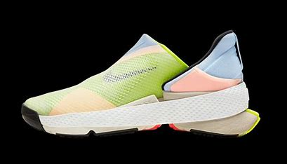
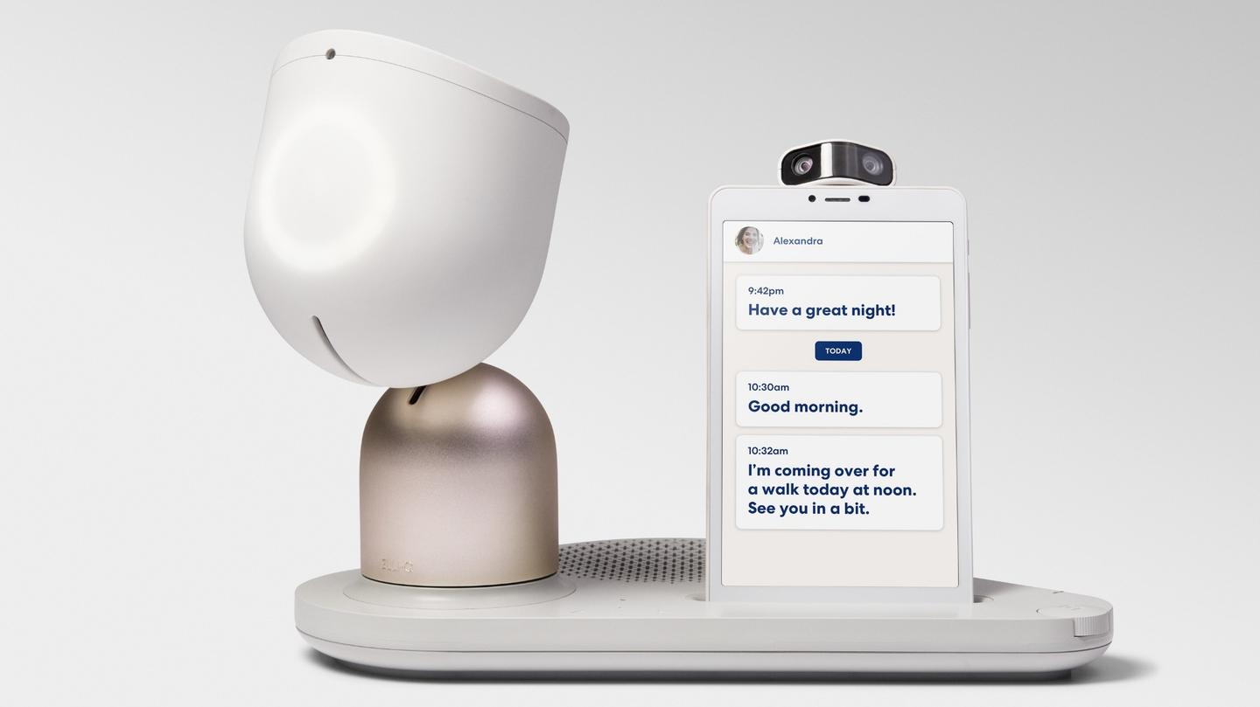
Elliq Release date: Mar 15, 2022

Slide 8
Thank You

